Slide 1
CENTRAL LIMIT THEOREM
specifies a theoretical distribution
formulated by the selection of all possible random samples of a fixed size n
a sample mean is calculated for each sample and the distribution of sample means is considered

Slide 2
SAMPLING DISTRIBUTION OF THE MEAN
The mean of the sample means is equal to the mean of the population from which the samples were drawn.
The variance of the distribution is σ divided by the square root of n. (the standard error.)

Slide 3
STANDARD ERROR
Standard Deviation of the Sampling Distribution of Means
σ_{x} = σ/ \/n

Slide 4

How Large is Large?
If the sample is normal, then the sampling distribution of will also be normal, no matter what the sample size.
When the sample population is approximately symmetric, the distribution becomes approximately normal for relatively small values of n.
When the sample population is skewed, the sample size must be at least 30 before the sampling distribution of becomes approximately normal.

Slide 5
EXAMPLE
A certain brand of tires has a mean life of 25,000 miles with a standard deviation of 1600 miles.
What is the probability that the mean life of 64 tires is less than 24,600 miles?

Slide 6
Example continued
The sampling distribution of the means has a mean of 25,000 miles (the population mean)
μ = 25000 mi.
and a standard deviation (i.e.. standard error) of:
1600/8 = 200

Slide 7
Example continued
Convert 24,600 mi. to a z-score and use the normal table to determine the required probability.
z = (24600-25000)/200 = -2
P(z< -2) = 0.0228
or 2.28% of the sample means will be less than 24,600 mi.

Slide 8
ESTIMATION OF POPULATION VALUES
Point Estimates
Interval Estimates

Slide 9
CONFIDENCE INTERVAL ESTIMATES for LARGE SAMPLES
The sample has been randomly selected
The population standard deviation is known or the sample size is at least 25.

Slide 10
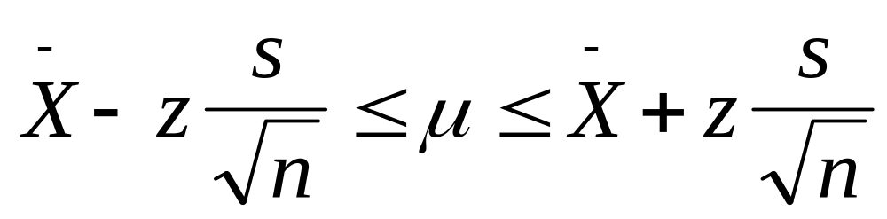
Confidence Interval Estimate of the Population Mean
₋
X: sample mean
s: sample standard deviation
n: sample size

Slide 11
EXAMPLE
Estimate, with 95% confidence, the lifetime of nine volt batteries using a randomly selected sample where:
₋₋
X = 49 hours
s = 4 hours
n = 36

Slide 12
EXAMPLE continued
Lower Limit: 49 - (1.96)(4/6)
49 - (1.3) = 47.7 hrs
Upper Limit: 49 + (1.96)(4/6)
49 + (1.3) = 50.3 hrs
We are 95% confident that the mean lifetime of the population of batteries is between 47.7 and 50.3 hours.

Slide 13
CONFIDENCE BOUNDS
Provides a upper or lower bound for the population mean.
To find a 90% confidence bound, use the z value for a 80% CI estimate.

Slide 14
Example
The specifications for a certain kind of ribbon call for a mean breaking strength of 180 lbs. If five pieces of the ribbon have a mean breaking strength of 169.5 lbs with a standard deviation of 5.7 lbs, test to see if the ribbon meets specifications.
Find a 95% confidence interval estimate for the mean breaking strength.

